Slide 1
Hypoxia
Dr.Dulani Kottahachchi
Department of Physiology

Slide 2
Objectives
List the types of hypoxia
Give examples for the different types of hypoxia
Outline the important differences among the different types of hypoxia
O₂ content
PaO₂
Understand the role of oxygen in treatment of hypoxia

Slide 3
What is ‘hypoxia’?
Hypoxia is any condition where there is oxygen deficiency at tissue or cellular level

Slide 4
What are the effects of hypoxia?
Reduced O₂ supply to tissues
Impairs mitochondrial function
Results in anaerobic glycolysis
VERY IMPORTANT *Brain cells are extremely sensitive to hypoxia

Slide 5
What are the types of hypoxia?
Hypoxic hypoxia (Hypoxemia)- arterial PO2↓
Anaemic hypoxia – Hb ↓
Stagnant hypoxia (Ischemic)- blood flow to tissue↓
Histotoxic hypoxia

Slide 6
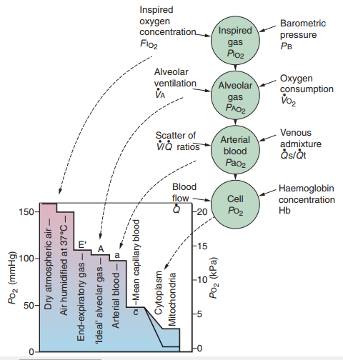
Oxygen cascade
Hypoxic hypoxia
Physiological shunt
Stagnant hypoxia
Anaemic hypoxia
Histotoxic hypoxia

Slide 7
What is Hypoxia hypoxia?
Hypoxaemia- reduced arterial PO₂
↓ PaO₂ and ↓ oxygenated Hb → ↓ O₂ content
Causes
Increasing altitude- alveolar Po2 falls progressively
Diseases causing Hypoxaemia
Ventilatory failure/respiratory pump failure
Gas exchange apparatus failure- Diffusion- pulmonary fibrosis
V/Q imbalance
Shunts
Notes:
Inspired gas Po2
Increased Oxygen consumption

Slide 8
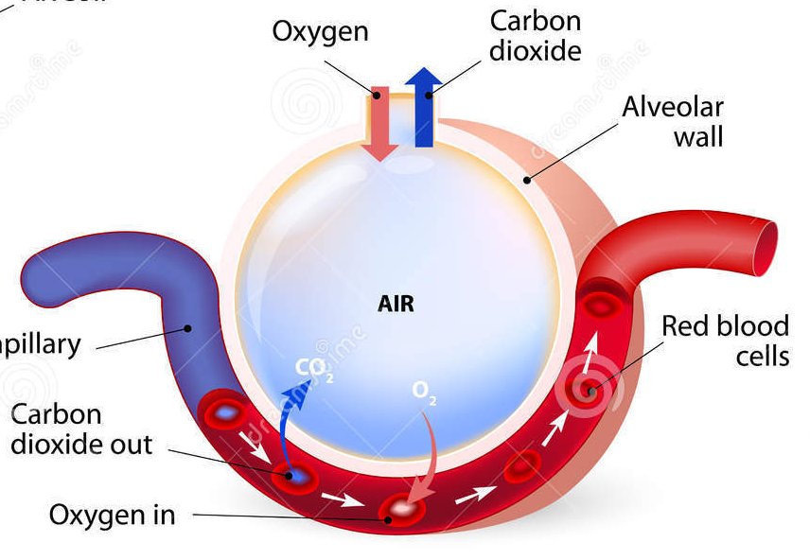
How does ventilatory failure cause hypoxic hypoxia?
Poor ventilation
↓ P_{A}O₂
↓ P_{a}O₂ and ↓ oxygenation of Hb
↓ P_{A}O₂
X
↓ P_{A}O₂
↓ P_{a}O₂ &↓HbO2

Slide 9
What are the causes of Ventilator failure?
Respiratory muscle fatigue
Mechanical defects
Airway obstruction : e.g foreign body impaction
Increased airway resistance : e.g. asthma
Skeletal deformities : e.g. kyphoscoliosis
Paralysis of respiratory muscles : e.g. polio, myaesthenia gravis
Shallow breathing : e.g. pleurisy
Pneumothorax
Neural control abnormalities
Depression of respiratory controller in brain eg. Morphine

Slide 10
Alveolar/arterial Po2 difference
Normal -does not exceed 2 kPa (15 mm Hg)
Rise to greater than 5 kPa (37.5 mm Hg)
In aged but healthy subjects
In a patient with any lung disease causing
Shunting
V/Q mismatching
↓ Diffusing capacity

Slide 11
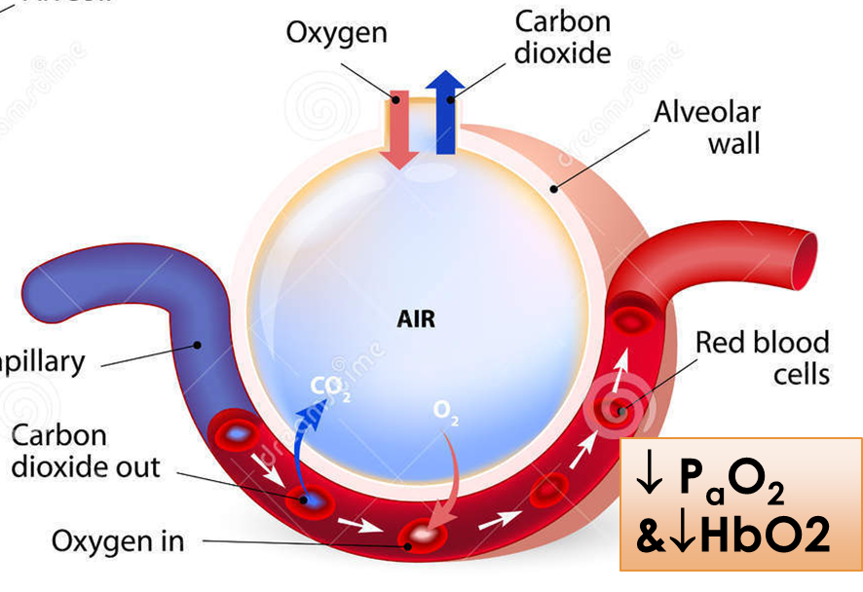
How does gas exchange failure cause hypoxic hypoxia?
A problem in the alveolar – capillary membrane resulting in ↓ diffusing capacity
e.g. pneumonia, pulmonary fibrosis
↓ diffusion →↓ P_{a}O₂ and ↓ oxygenation of Hb
n P_{A}O₂
X

Slide 12
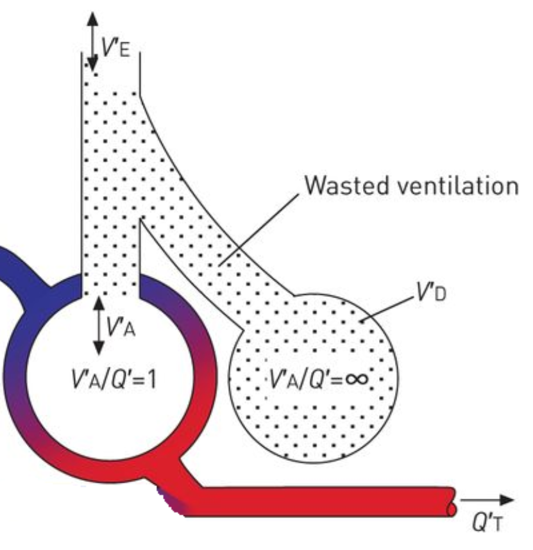
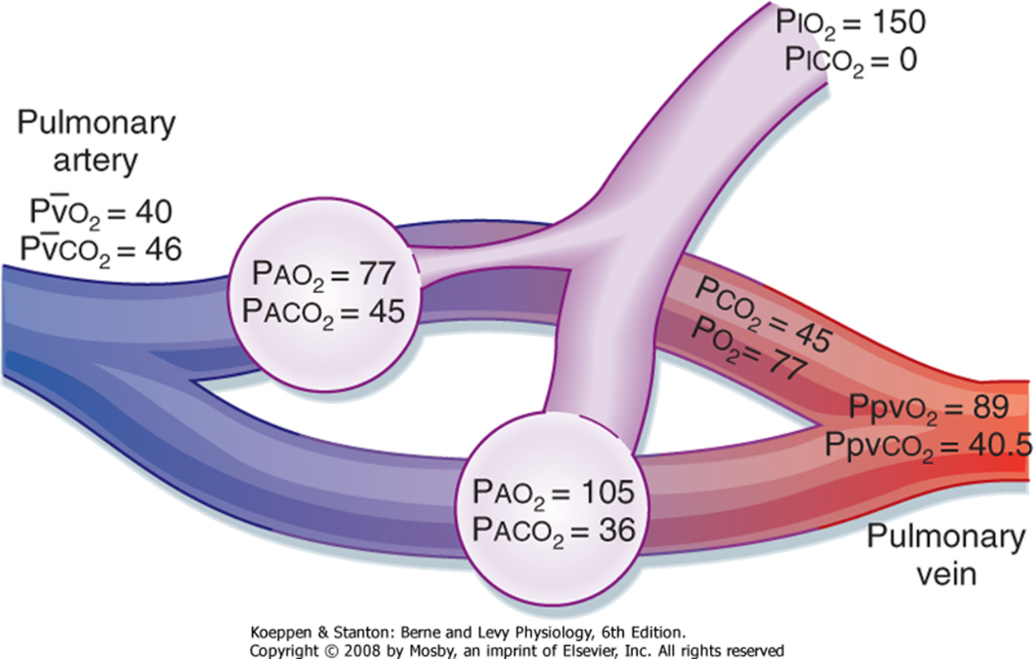
How does Ventilation/Perfusion imbalance cause hypoxic hypoxia?
Areas of over-ventilation with under-perfusion –Dead space
Areas of under-ventilation with over-perfusion – Physiological Shunt

Slide 13
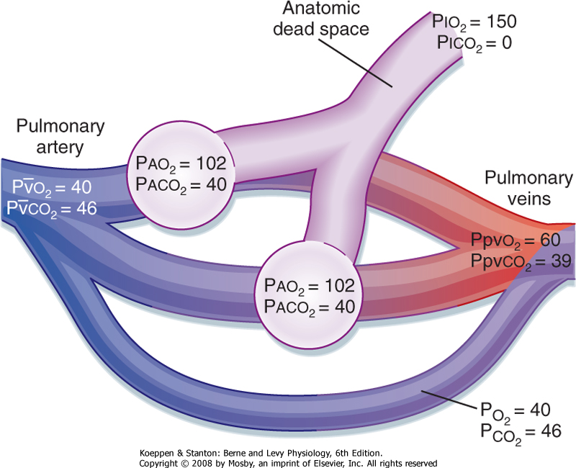
How do shunts cause hypoxic hypoxia?
Some venous blood bypasses lungs completely
This has the composition of mixed venous blood
Mixes with oxygenated blood
↓ PaO₂ and O₂ content
Bypass the gas exchanging unit

Slide 14
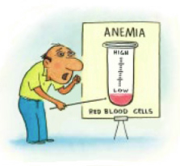
What is anaemic hypoxia?
Hyopxia due to anaemia
Not sever at rest unless Hb↓ ↓
↓ O₂ carrying capacity due to ↓ functioning Hb
Normal PaO₂
But ↓ O₂ content (due to ↓ HbO₂)
Notes:
Greeks and Romans used CO to execute criminals

Slide 15
What are the causes of anaemic hypoxia?
↓ Hb concentration :
eg. Blood loss
Decreased red cell production
Abnormal Hb : reduced binding of O₂
eg. Methaemoglobinaemia
Sulphaemoglobinaemia
Carbon monoxide (CO) poisoning (type of anaemic hypoxia)

Slide 16
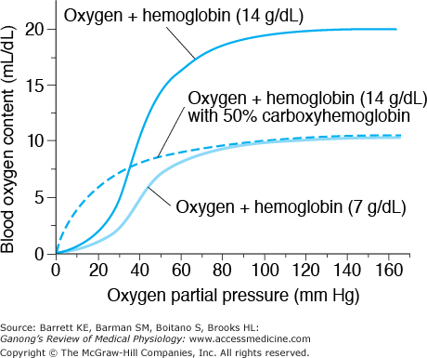
Effects of anaemia and CO on Hb binding of O2
Left shift of O2 dissociation curve with COHb
Decreased amount of O2 release

Slide 17
More about carbon-monoxide poisoning Carboxyhaemoglobinaemia
Total Hb content is normal
Deficiency of Hb that can carry O₂
CO has an affinity 210 x that of O₂ for Hb
Bound CO-Hb releases CO very slowly
Shifts Hb-O₂ curve to the left
Loses sigmoid shape
Mild toxic effect to cytochromes in tissues
PaO₂ is normal – therefore no stimulation of peripheral chemoreceptors

Slide 18
What is stagnant hypoxia/Ischemic hypoxia?
Due to slow circulation:
Vascular Disease- Local vasoconstriction
Reduced cardiac output
There is excessive extraction of O₂
Results in peripheral cyanosis
Occurs where there is slow circulation
eg. shock, congestive heart failure

Slide 19
What is histotoxic hypoxia?
Normal PaO_{2,} O₂ content, Hb content and saturation
But inability of mitochondria to utilize O₂
e.g. Cyanide poisoning

Slide 20
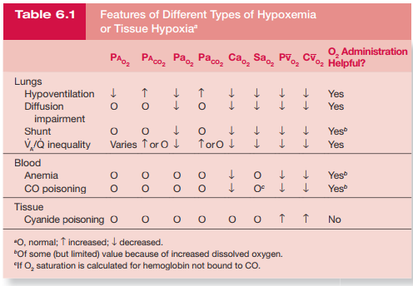

Slide 21
How to treat hypoxias ?

Slide 22
O₂ therapy
Beneficial in hypoxic hypoxia except in shunts
Administration of high partial pressure of O₂
↑ P_{i}O₂ → ↑ P_{A}O₂ → ↑ P_{a}O₂ in blood leaving lungs
Generally administer < 100% O₂
Care in chronic hypoxia – loss of hypoxic drive

Slide 23
What is hyperbaric O₂ therapy?
Short periods of O₂ is administered at pressures above atmospheric pressure
↑ amount of O₂ is dissolved in plasma
Used to treat:
CO poisoning- high P_{O2} displaces CO bound to Hb
Decompression sickness
Air embolism

Slide 24
What is the problem with O₂ therapy?
O₂ toxicity - H₂O₂, O₂⁻

Slide 25
Some special conditions and circumstances
Asphyxia
Hypocapnoea
Hypercapnoea

Slide 26
Asphyxia
Occlusion of airways
Acute hypercapnoea and hypoxia
Stimulates respiration – violent respiratory efforts
Increased BP, HR, sympathetic output, reduced pH
Gradual decrease in respiratory efforts
Decreased BP, HR
Revived by artificial respiration ; if not- cardiac arrest in minutes

Slide 27
Hypocapnoea - ↓ PaCO₂
Result of hyperventilation
Direct constrictor effect on blood vessels leading to cerebral ischaemia ; ↓ cerebral blood flow by 30%- CNS symptoms
Direct constrictor effect on peripheral blood vessels but depresses vasomotor center
Therefore maintains blood pressure
Hypocapnoea increases cardiac output
Results in Respiratory alkalosis

Slide 28
Hypercapnoea - ↑ PaCO₂
Initially stimulates respiration
↑PaCO₂ levels → depression of CNS
Severe respiratory acidosis is seen

Slide 29
Summary
Listed the types of hypoxia
Gave examples for the different types of hypoxia
Outlined the important differences among the different types of hypoxia
O₂ content
PaO₂
Understood the role of oxygen in treatment of hypoxia

